Slide 1

Prompt Engineering: Unlocking the Power of AI
Welcome to Prompt Engineering: Unlocking the Power of AI! I'm J. Mani, and I'll be guiding you through the fundamentals of this rapidly evolving field. We'll explore the key concepts, effective techniques, and practical applications of prompt engineering.
J.Mani
23071A6724

Slide 2
Introduction to Prompt Engineering
Prompt engineering involves crafting precise instructions, called prompts, that guide AI models like ChatGPT to generate desired outputs.
These prompts are the key to unlocking the full potential of AI models, enabling you to achieve specific tasks and generate creative text, code, or other outputs.

Slide 3
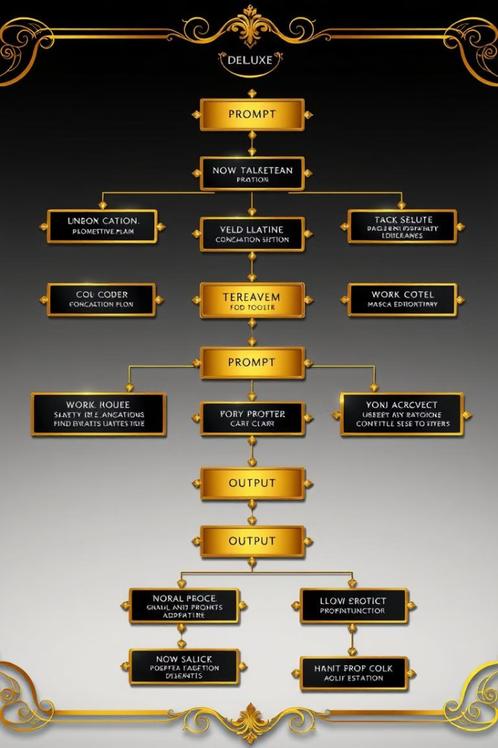
The Fundamentals of Prompt Design
1
Clarity and Specificity
2
Contextual Information
Clear and concise instructions are essential for producing accurate results.
Providing relevant background information helps the AI model understand the desired output.
3
Output Format
Specify the desired format, such as a poem, code, or summary, to ensure the AI generates the appropriate output.

Slide 4

Techniques for Effective Prompt Engineering
Few-Shot Learning
Chain of Thought
Provide examples of desired outputs to guide the AI model towards the intended result.
Break down complex prompts into smaller steps, allowing the AI to reason through the problem.
Role Playing
Define specific roles for the AI and users to guide the conversation and generate context-specific outputs.

Slide 5




Case Studies: Successful Prompt Engineering Applications
Content Creation
Generating high-quality blog posts, articles, and social media content.
Code Generation
Writing code snippets, functions, and even complete applications.
Language Translation
Translating text between languages with high accuracy and fluency.

Slide 6



The Future of Prompt Engineering: Trends and Innovations
Increased Automation
1
Prompt engineering will automate more tasks, freeing up human time for creativity and problem-solving.
Personalized AI Experiences
2
AI systems will be tailored to individual preferences and needs through effective prompt design.
Democratization of AI
3
Prompt engineering will make AI accessible to a wider audience, empowering individuals and businesses.

